Slide 1
TIME TABLE MANAGEMENT
Vijay Sehgal
1812390
CSE 3rd Year(A2)

Slide 2
COMPANY PROFILE
Grapess Solutions has started in March,2010 with a vision to provide every solution of IT. We have started with IT education & training and software solution.
In Web Design & Development:
Grapess Solutions provides professional website design, development and maintenance services. Our experienced web designers and developers carry out various website projects from brochure sites to multi-functional web portals. Grapess Solutions has a large team of resources and the required business and technical expertise to develop websites of any complexity. We provide complete front-end and back-end development based on the latest technologies and industry trends.

Slide 3
LANGUAGE USED:JAVA
Java is both a programming language and a platform.
Earlier it was called “Oak”.
Java is related to C++ which is a direct descendant of C.
It is a high level language which has following Features:
Simple
Object Oriented
Distributed
Interpreted
Robust
Secure
Portable
Multithreaded

Slide 4
CONTINUE…..
Java The Platform: A platform is the hardware or software environment in which a program runs. The Java platform has two components:
The Java Virtual Machine (Java VM)
The Java Application Programming Interface (Java API)
Java Virtual Machine is standardized hypothetical computer,
which is emulated inside our computer by a program.
The Java API is a large collection of ready-made software components that provide many useful capabilities, such as graphical user interface (GUI) widgets.

Slide 5
ABOUT PROJECT
Time Table Management is a part of an organization where user can manage the timetable of an organization.
This project specifies all the working that are done by Timetable manager.
It is really difficult to make the time table by other means like Ms Word or Excel as they consume time. Whereas in this project a user just have to enter the record with ease. No other problem of saving the files or docs etc.
In this project user has a facility to edit the data or crosscheck the data in the Frontend only no need to use the backend for any editing.

Slide 6
PROJECT DESC
Login Screen: This is used to check the user who is entering in the portal is an authorized one or not. For this user gets a Login Screen where he has to enter his Username & password to access the portal.
Subject Information: This is used to enter the subjects along with their Ids for their use in Time Table for children as well as faculty.
Faculty Information: This is used to enter the faculty description so that a particular subject can be allotted to faculty person.
Room Information: This is used to enter the room information where the lectures, seminars and tutorials etc. will be conducted.
Faculty Subject: In this the faculty is choosed and the subject is allotted to the him/her so that it can be added in the time table.

Slide 7
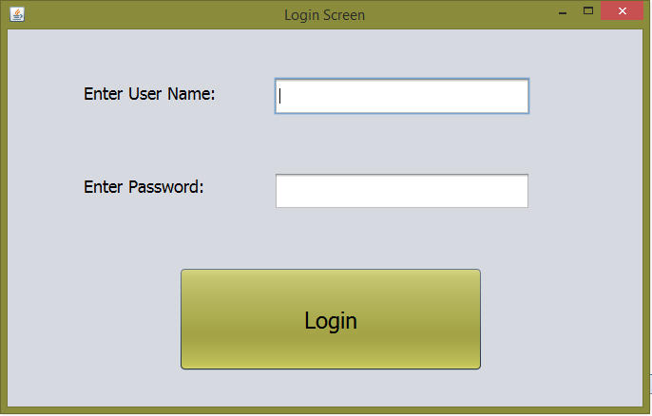
OUTPUT: LOGIN SCREEN

Slide 8
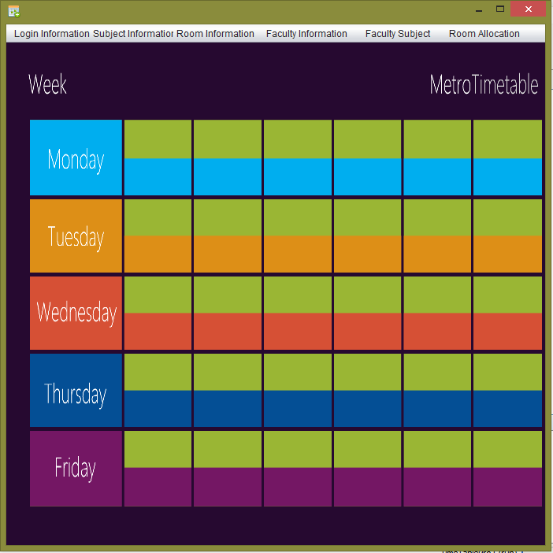
MAIN SCREEN:

Slide 9
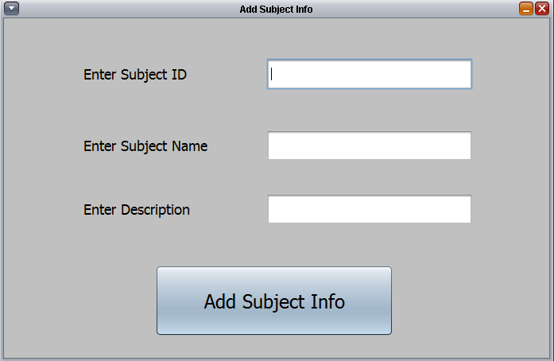
ADD SUBJECT INFORMATION

Slide 10
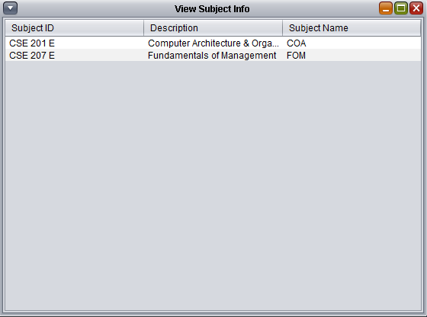
VIEW SUBJECT INFORMATION

Slide 11
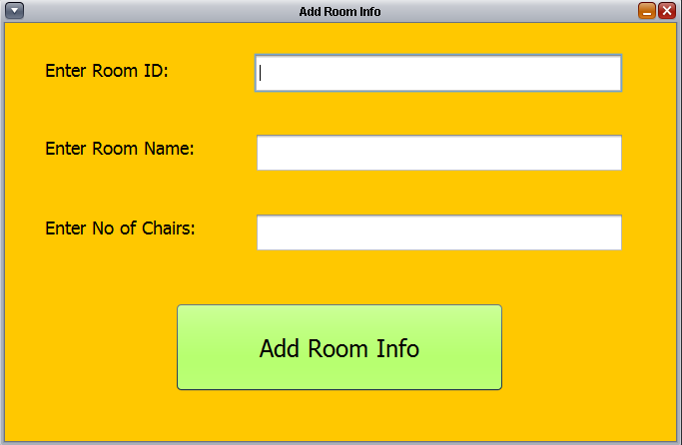
ADD ROOM INFORMATION

Slide 12
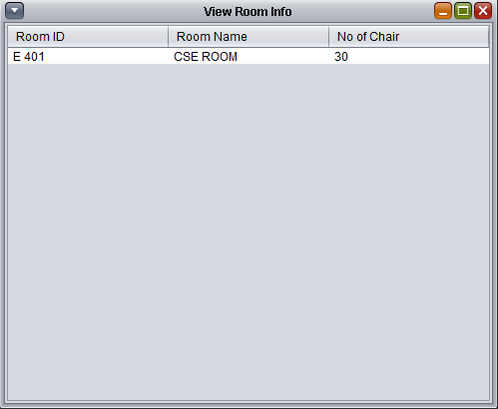
VIEW ROOM INFORMATION

Slide 13
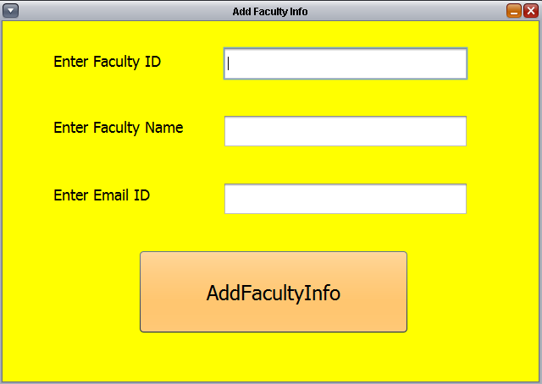
ADD FACULTY INFORMATION

Slide 14
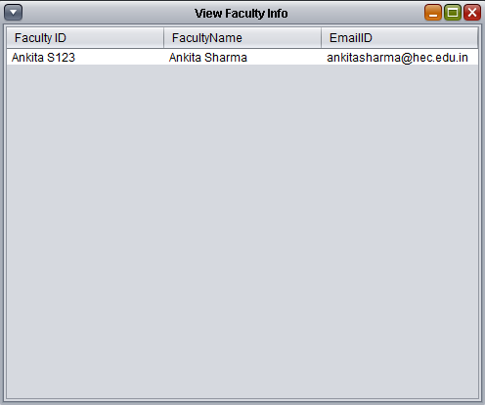
VIEW FACULTY INFORMATION

Slide 15
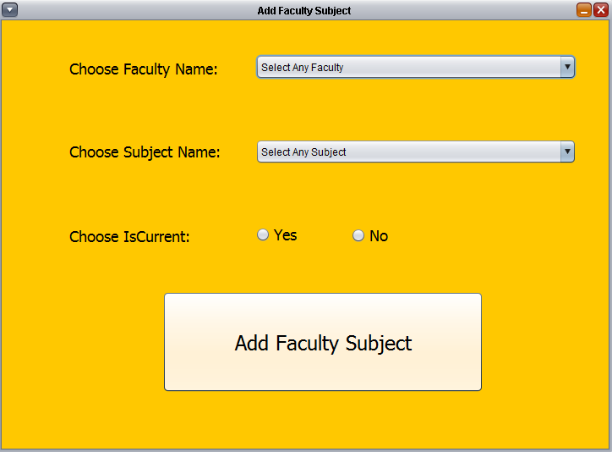
ADD FACULTY SUBJECT

Slide 16
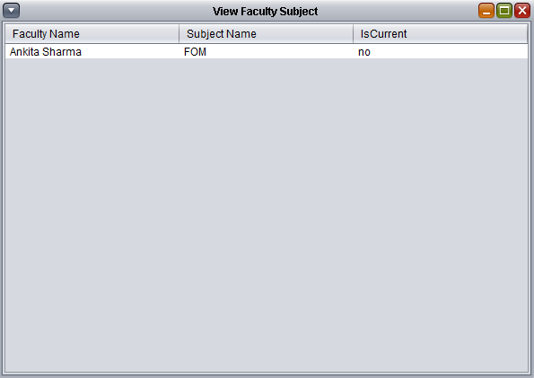
VIEW FACULTY SUBJECT

Slide 17
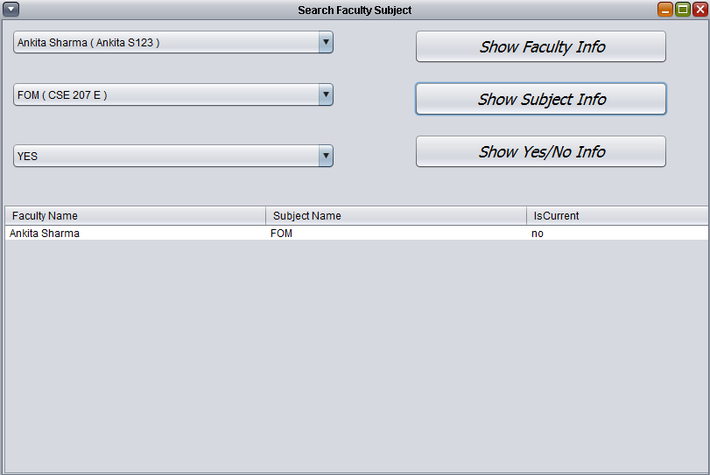
SEARCH FACULTY SUBJECT

Slide 18
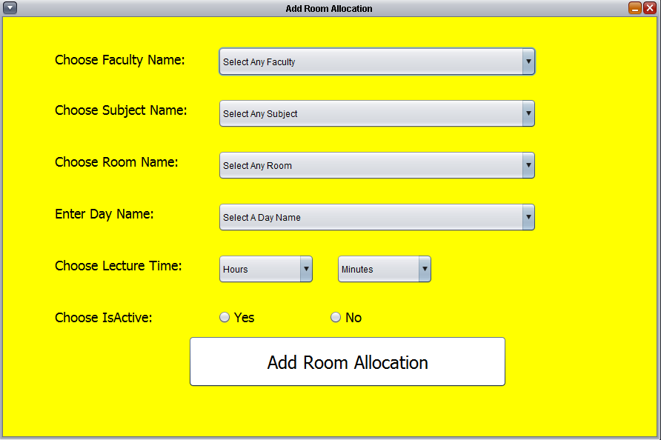
ALLOCATION OF ROOM

Slide 19
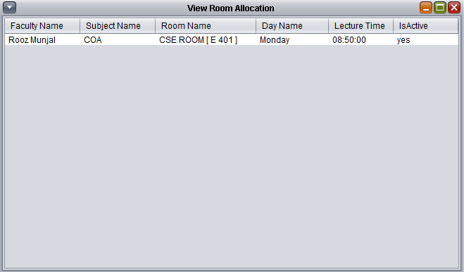
VIEW ALLOCATION OF ROOM

Slide 20
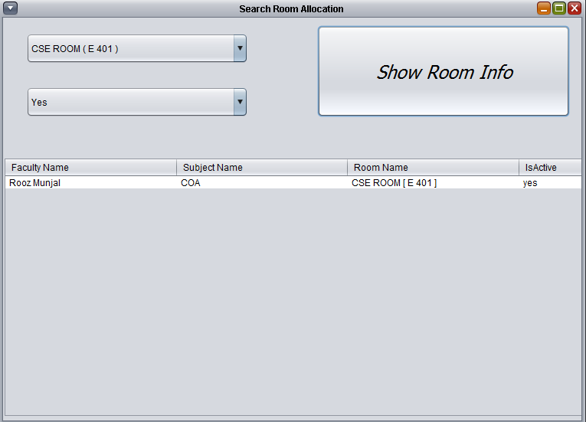
SEARCH ROOMS ALLOTTED

Slide 21
CONCLUSION
Hence, Time table management plays an important role in every organisation’s and individual’s life. Through this project, we can easily manage the time table of various regular classes in an organisation.
The primary mission of the Time table management is to ensure that all the people in an organisation whether school or college can make the best use of it by creating the time table of various classes with an ease without any strong efforts

Slide 22
THANKS
Q/A

